Slide 1







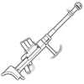

















































11eRC-FL Stockpile Template
This is the content of Operational Stockpiles that the 11eRC-FL expect
for each operation made by the regiment.
Small Arms ( Crate )
Heavy Arms ( Crate )
H.Ammo ( Crate )
COMETA
.44
HANGMAN
.44
NEVILLE
.20
30mm
40mm
68mm
40
20
20
5
50
80
50
30
100
80
BRASA
RACA
7.62
FOEBREAKER
RPG
CUTLER
RPG
10
5
5
20
50
100
SAMPO
7.62
BLAKEROW
7.62
CINDER
7.62
CREMARI
300
50
50
200
50
50
100
25
20
30
50
50
60
FIDDLER
9
LIAR
9
BONESAW M.
ATRPG
BONESAW
ATRPG
H.Ammo ( Ammo Facility )
200
100
25
20
40
80
AALTO
7.92
BOOKER
7.92
WILLOW’S
500
300
100
60
20
10
MALONE
12.7
RATCATCHER
12.7
3000
3000
200
1500
80
30
20
500
1500
150
100
100
40
150
60
100
Juillet 2023

Slide 2























































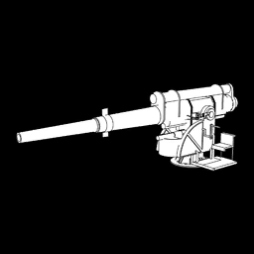







11eRC-FL Stockpile operation
This is the content of Operational Stockpiles that the 11eRC-FL expect
for each operation made by the regiment.
Equipment ( Crate )
Uniforms ( Crate )
Medical / Supplies
( Crate )
Materials ( Crate )
50
50
40
60
80
200
25
50
50
50
50
10
30
40
30
60
600
300
400+
20
10
300
50
25
25
50
25
25
50
20
30
30
10
30
60
9999
250
250
Emplacements
( Crate/Stockpile )
Materials ( Facility )
Starbreaker
For Iron, Alluminium and Copper, it is necessary to :
put in a stockpile or contact a TM ( if using TM System)
put in engineering Center and make protos out of it. ( If No TM System running )
94.5
12000
6000
20000
7500
250
*
*
-/*
AM1
AM3
AM4
AM5
AM2
25000
25000
1500
1500
150
5/*
5/*
Juillet 2023

Slide 3


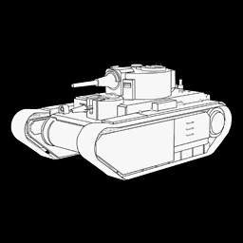










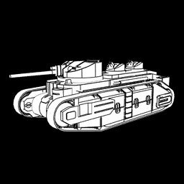



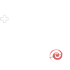

















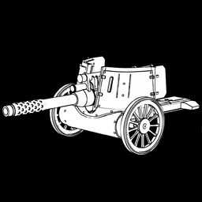






11eRC-FL Stockpile operation
This is the content of Operational Stockpiles that the 11eRC-FL expect
for each operation made by the regiment.
Vehicles ( Crate / Stockpile )
Flood Juggernaut MK VII
Flood MK I
0/0
0/0
0/0
-/*
-/*
10/20
-/5
ACV
Wildjack
Supertank
Firetruck
King Chester
Knave
5/10
-/*
5/10
5/10
10/20
5/*
5/10
5/10
10/*
5/10
1/1
0/1
0/1
0/1
Stockade
STD
Highwayman
Firebrand
75
68
1/1
1/1
5/*
5/*
10/*
5/*
5/*
Juillet 2023

